Slide 1




Welcome to The Caribbean
Team 6
Ankit Kumar Bhushanwar
Daniel Torres
Fangxiao Wu
Krutika Amberkar
P. M. Esienam Agbenorto
The Caribbean and (Parts of) Latin America

Slide 2

Presentation Outline
Data Quality
Regional Overview
Findings
Limitations
Conclusions

Slide 3
Data Quality
Missing Values
Reasons
Strategies
Find Data
Estimate
Discard Column
Outliers
Reasons
Strategies
Visual Exploration
Statistical Tools

Slide 4
Region Overview
Tourist Destinations
Susceptibility to Natural Disasters
Tax Havens & Offshore Financial Hubs
Territorial Ties
Lowest GDP & GDP Growth Rate
Significant GDP per capita
Sub-divided into Three Income Groups
Notes:
Okay now buckle up cause we are bringing you guys to a journey of a tropical land, the Caribbean.

Slide 5
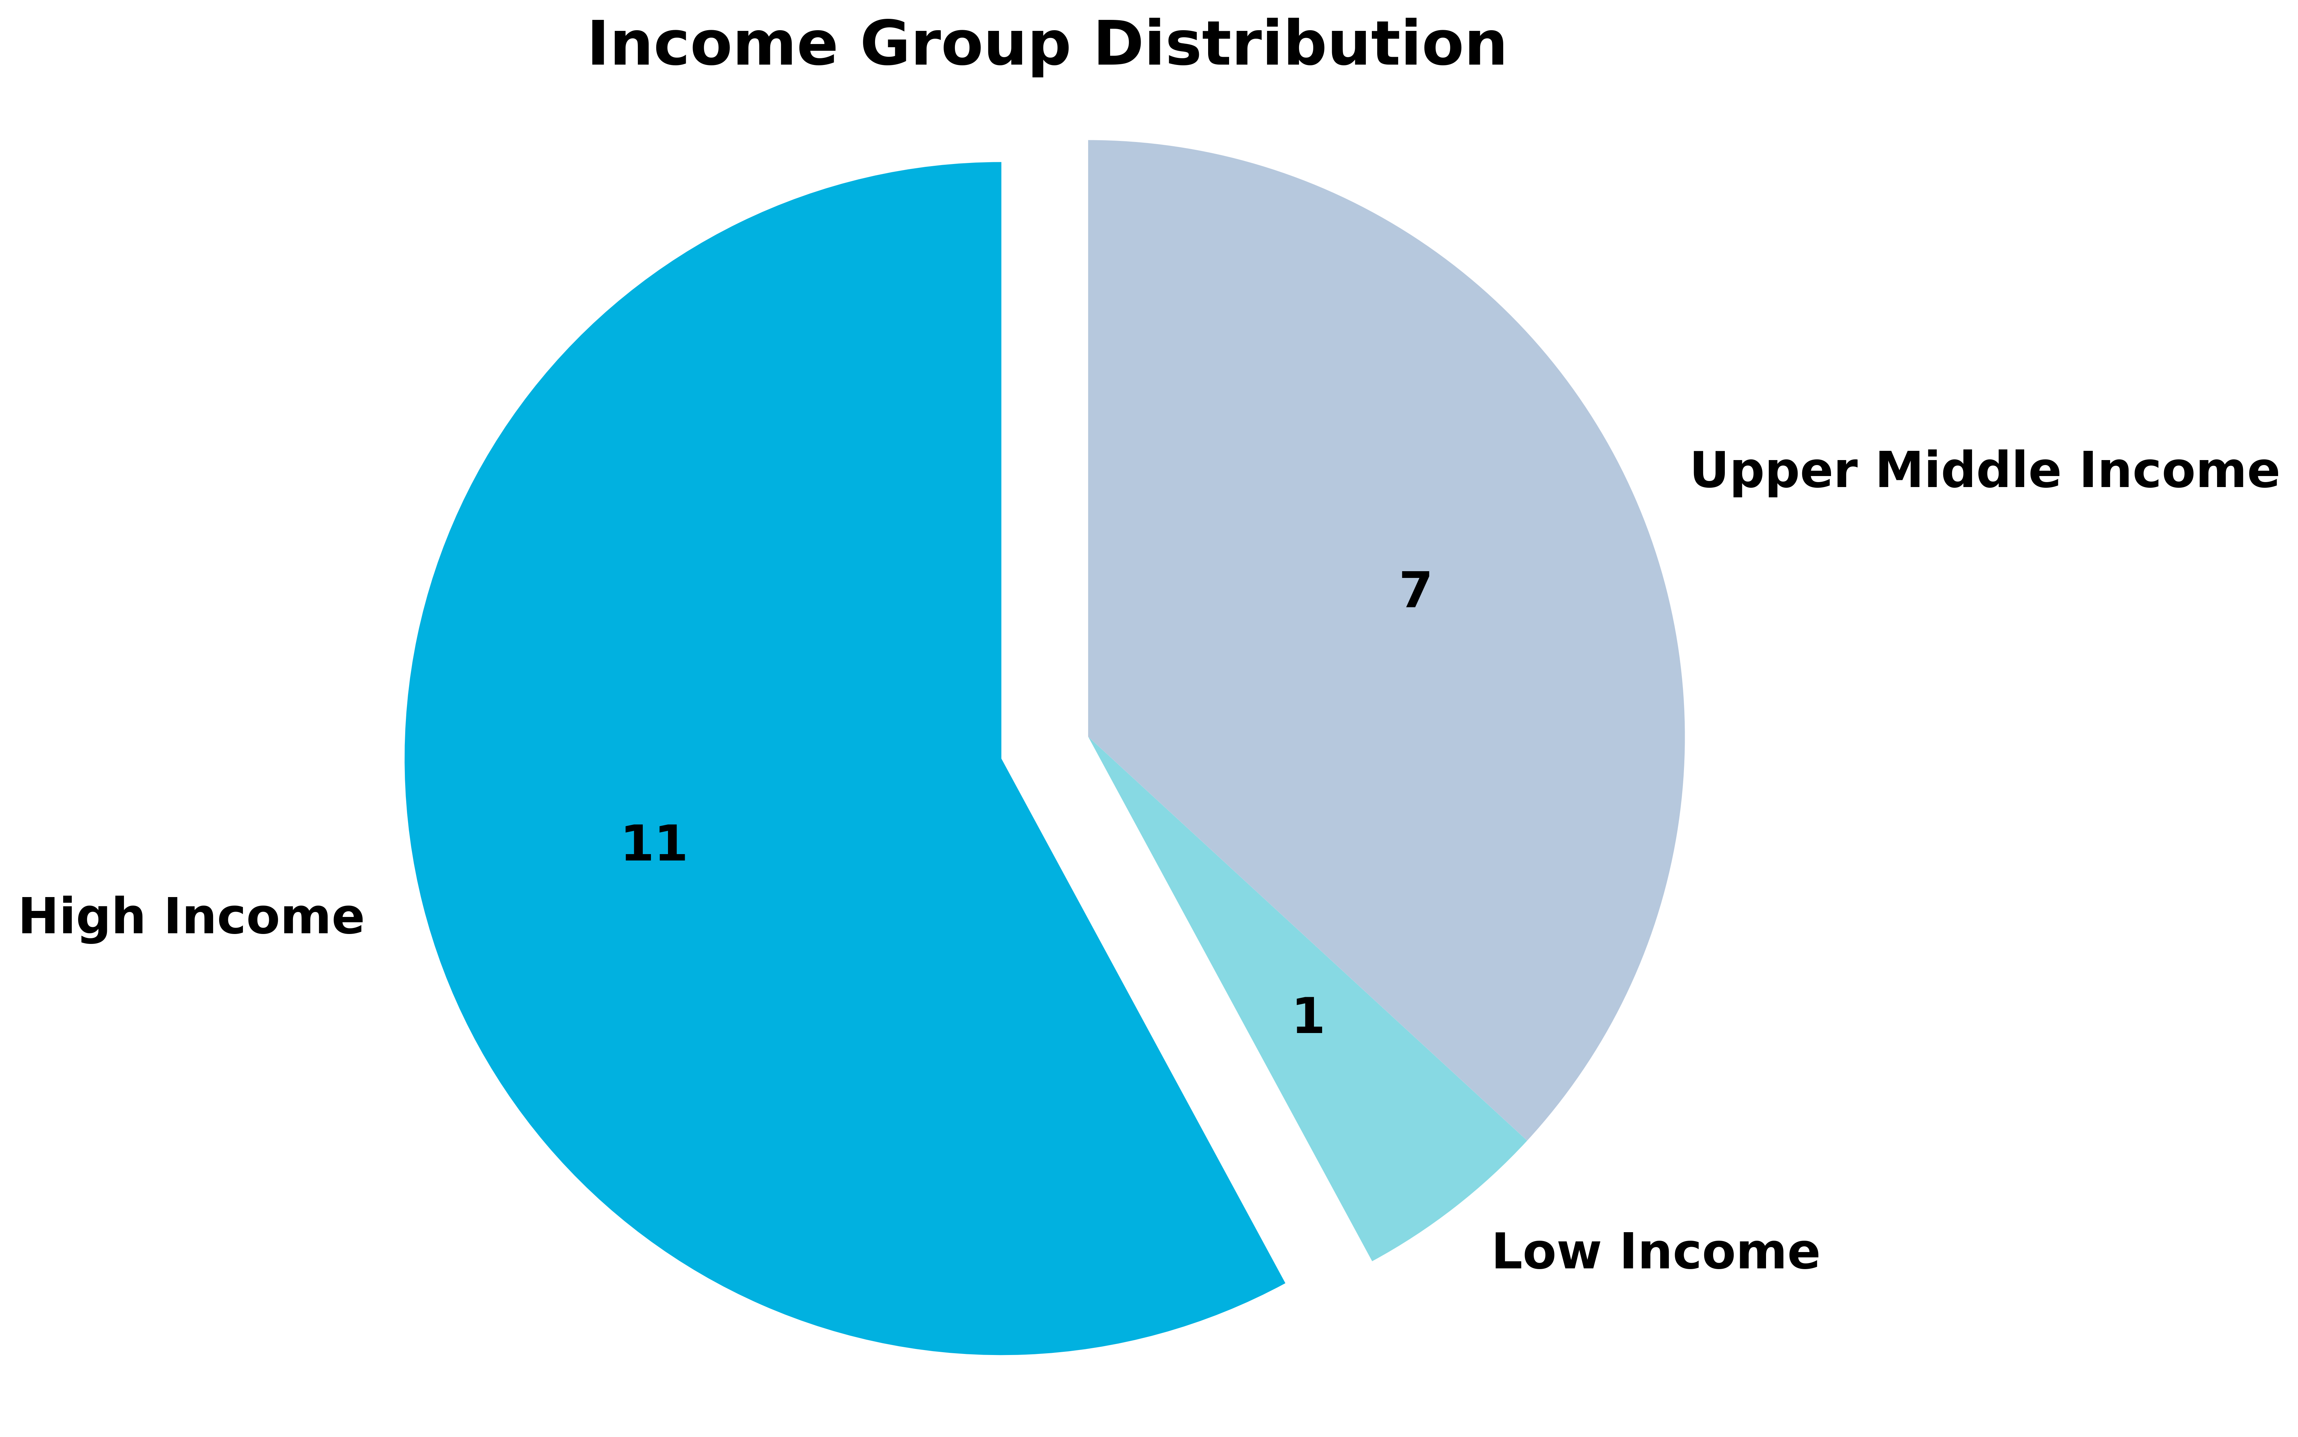
Income Groups
High Income
Antigua & Barbuda
Aruba
Upper Middle Income
Cuba
Dominican Republic
Low Income
Haiti
The Bahamas
Barbados
British Virgin Islands
Cayman Islands
Puerto Rico
St. Kitts & Nevis
Trinidad & Tobago
Turks & Caicos Islands
Virgin Islands U.S.
Dominica
Grenada
Jamaica
St. Lucia
St. Vincent & the Grenadines

Slide 6

Haiti
Demographics
Only low-income country
2nd highest population
Highest birth rate, lowest skilled birth staff
Lowest access to electricity
Lowest life expectancy
Highest dependency ratio of young

Slide 7
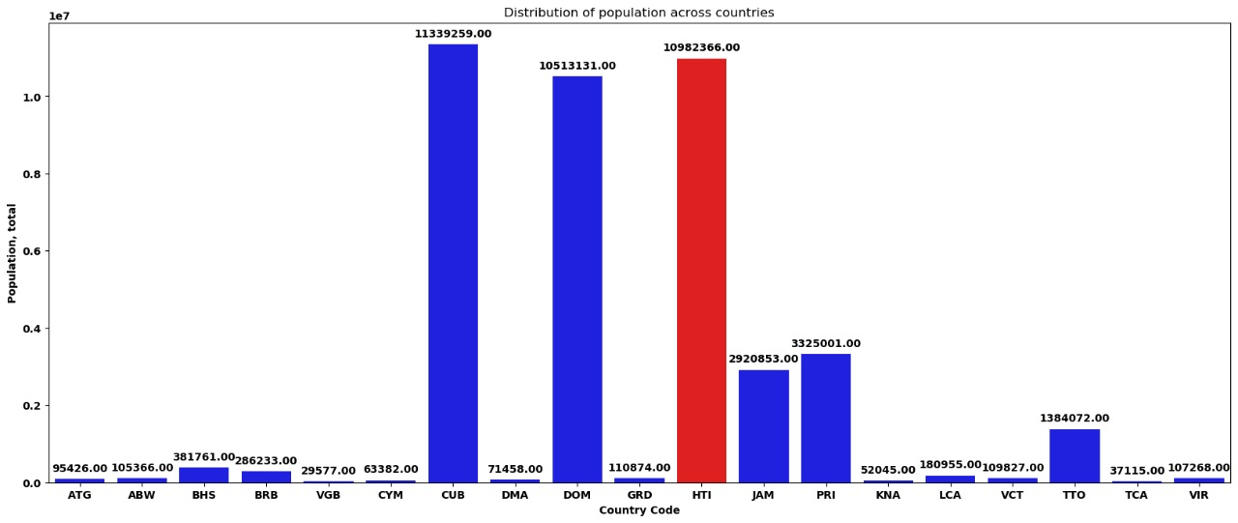
2nd Highest Population

Slide 8
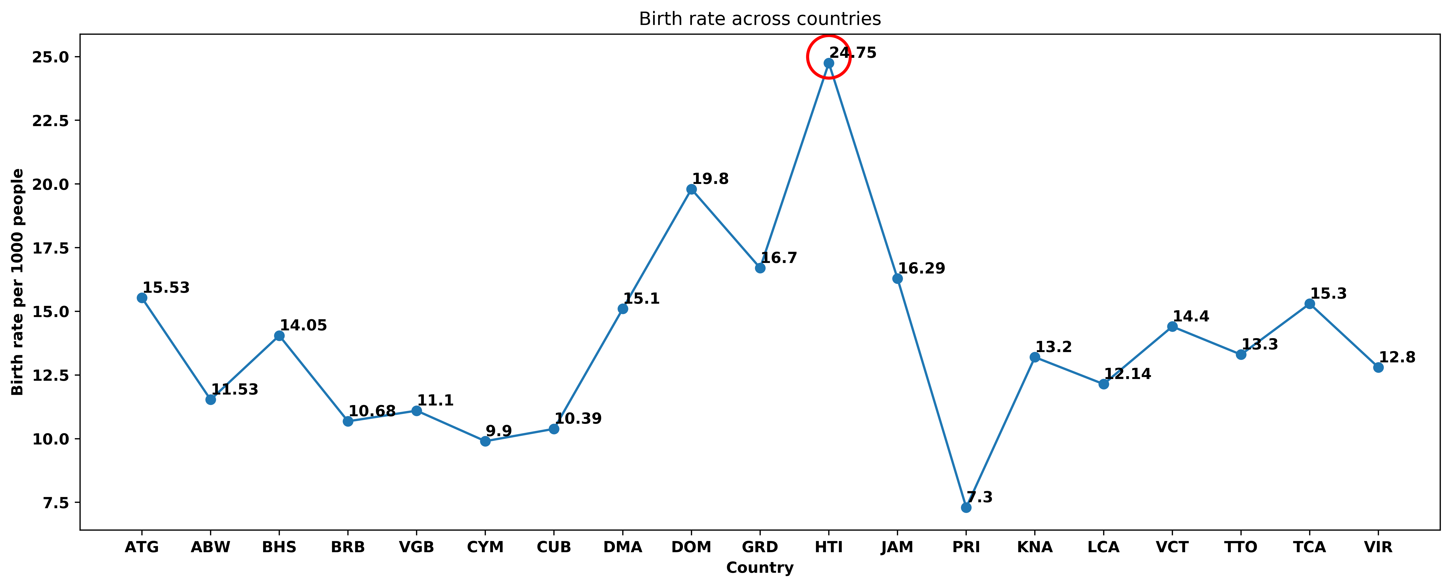
Highest Birth Rate

Slide 9
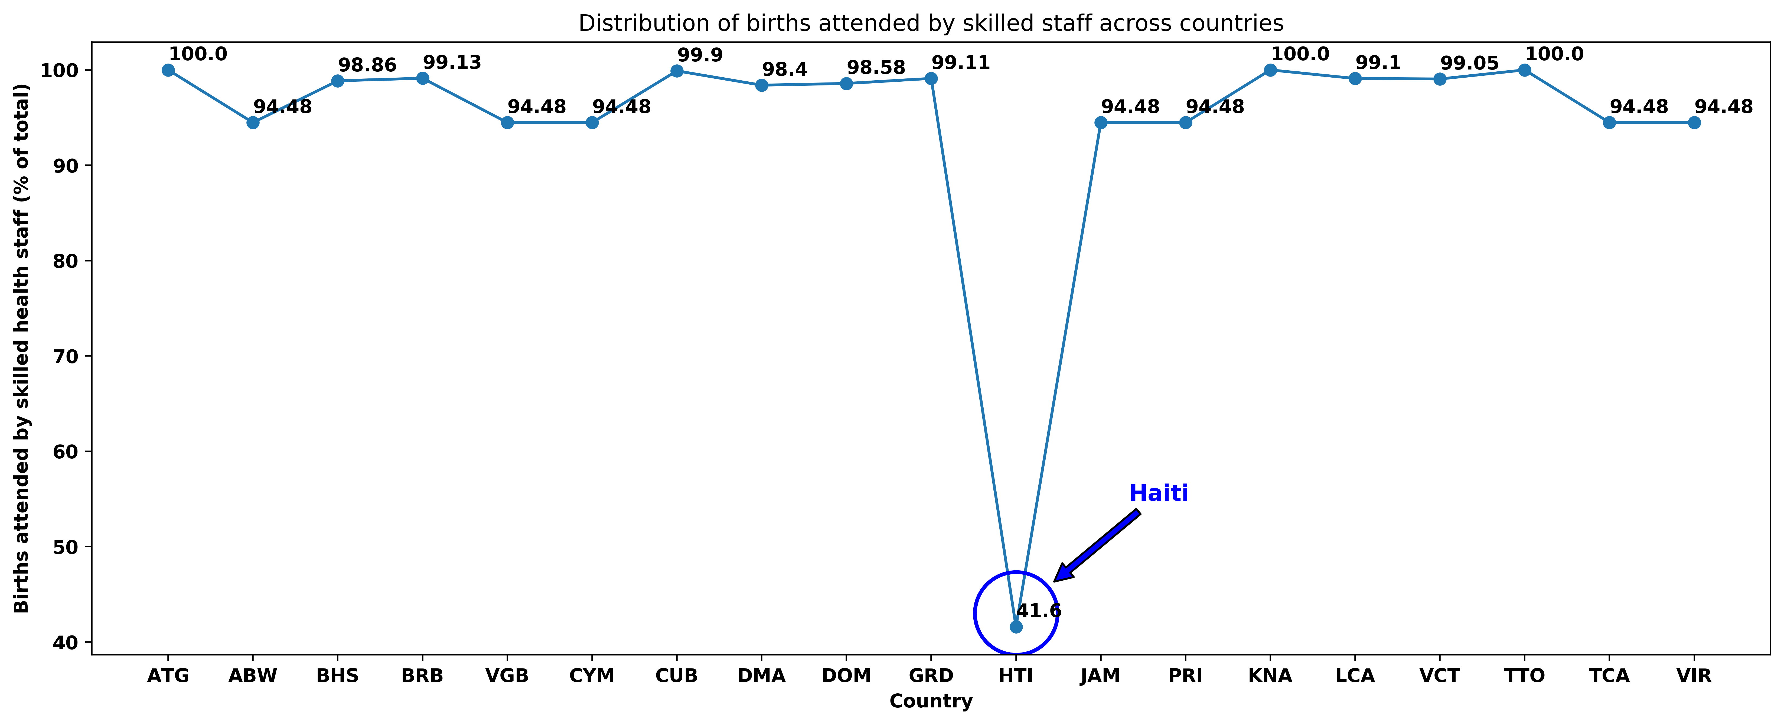
Lowest Births Attended by Skilled Staff

Slide 10
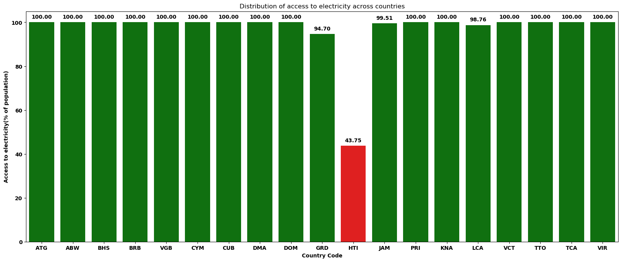
Lowest Access to Electricity

Slide 11
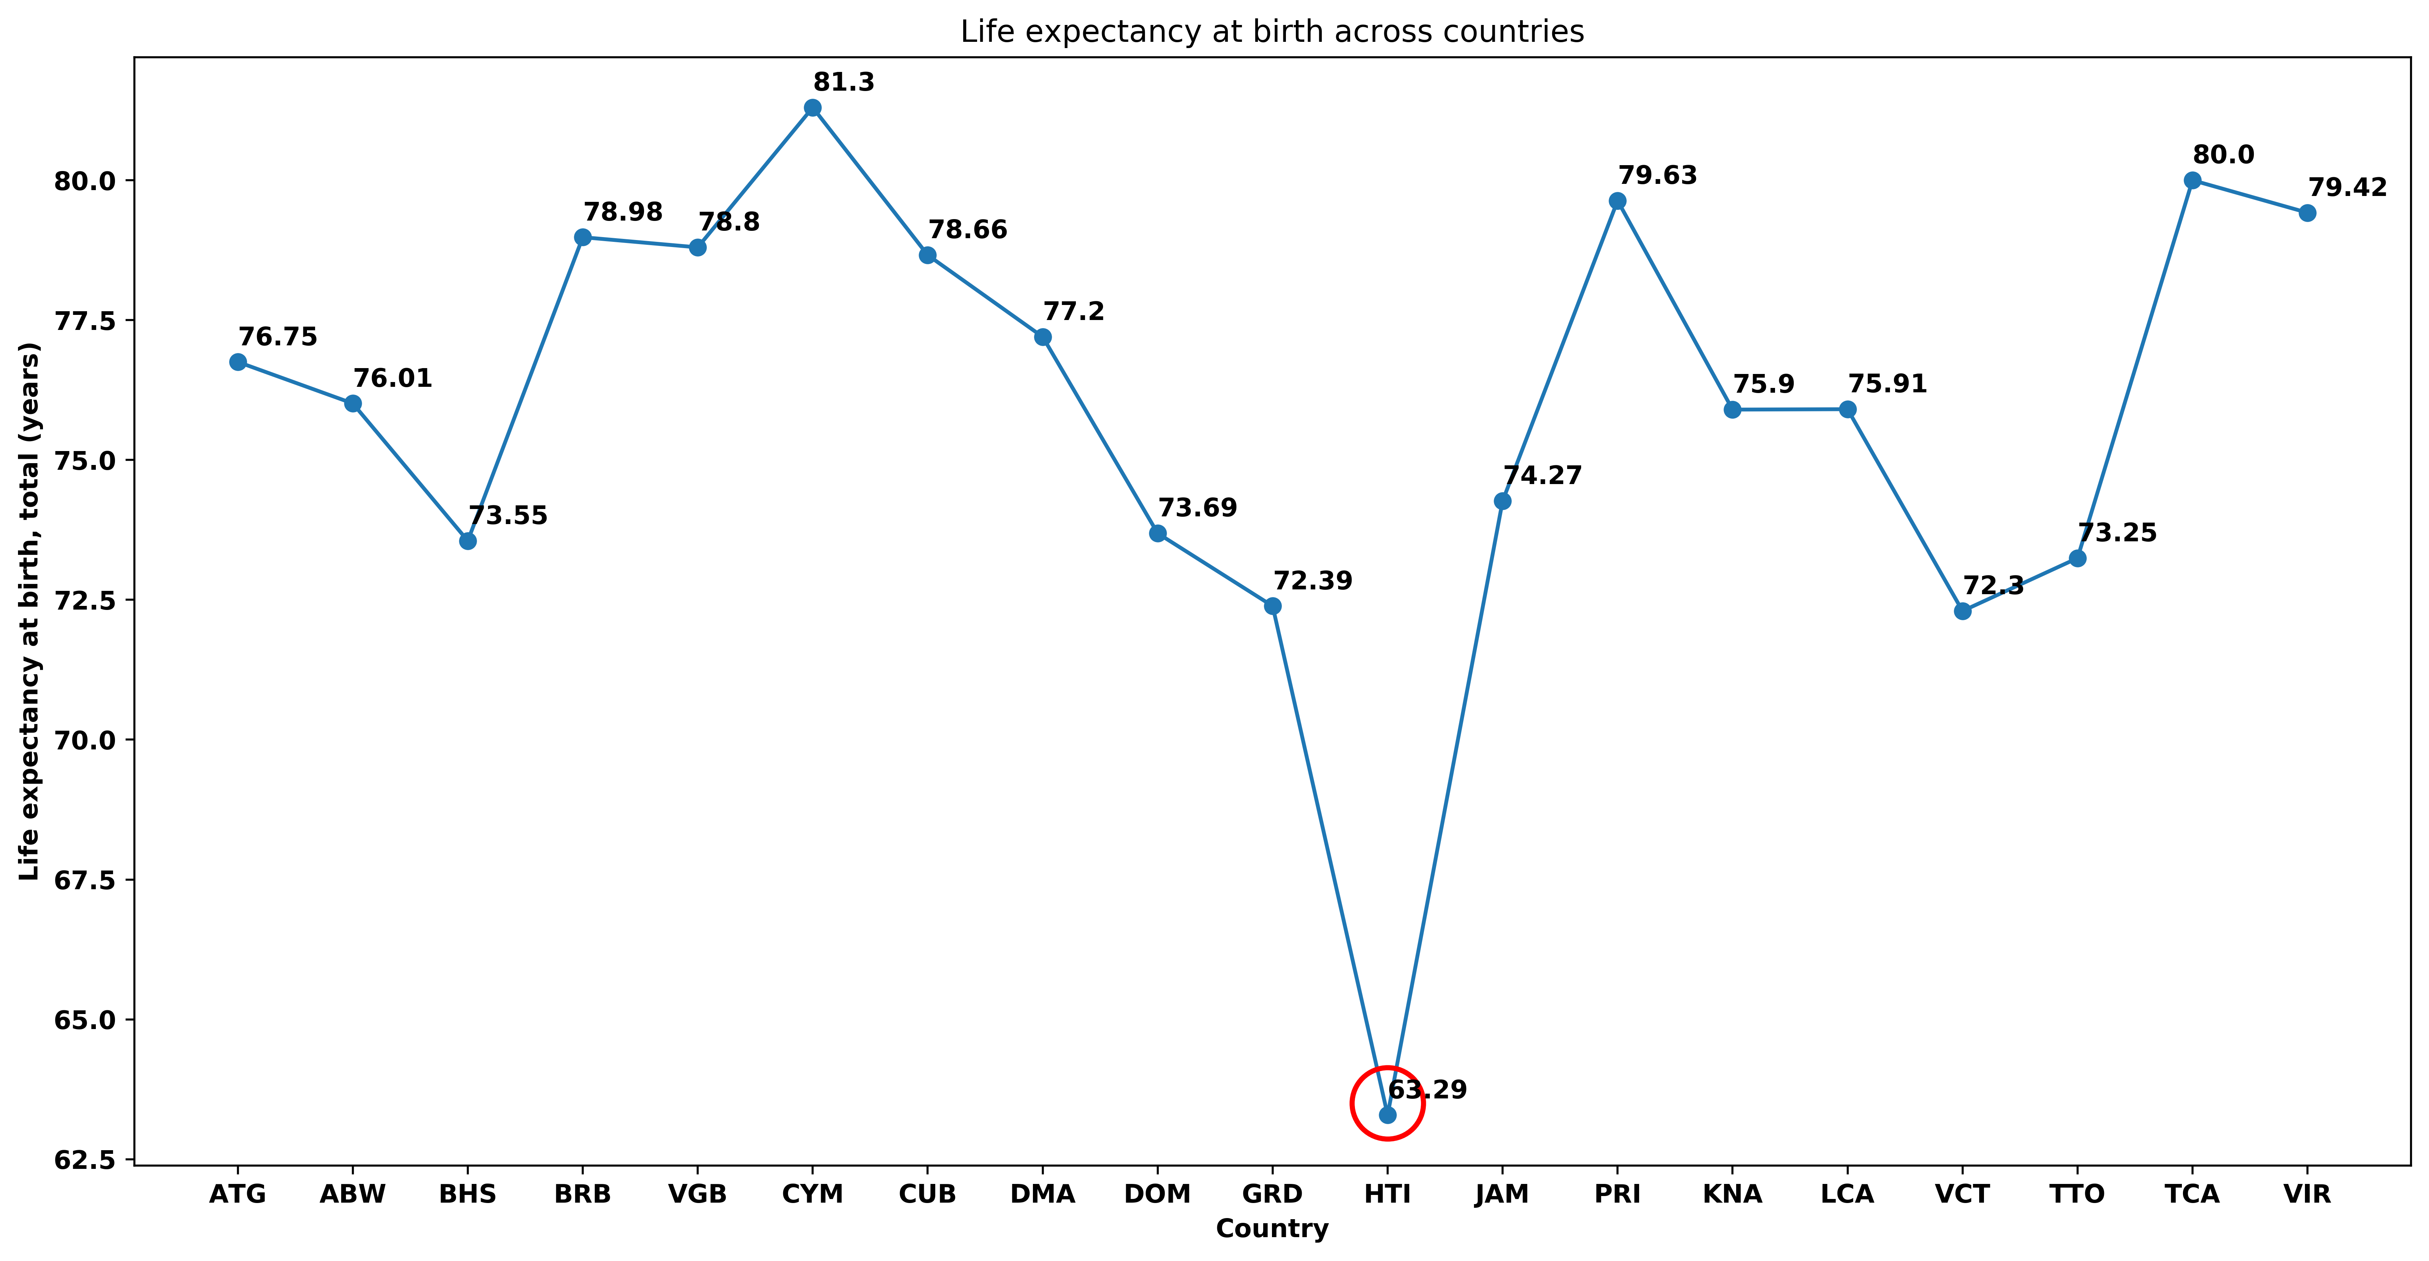
Lowest Life Expectancy

Slide 12
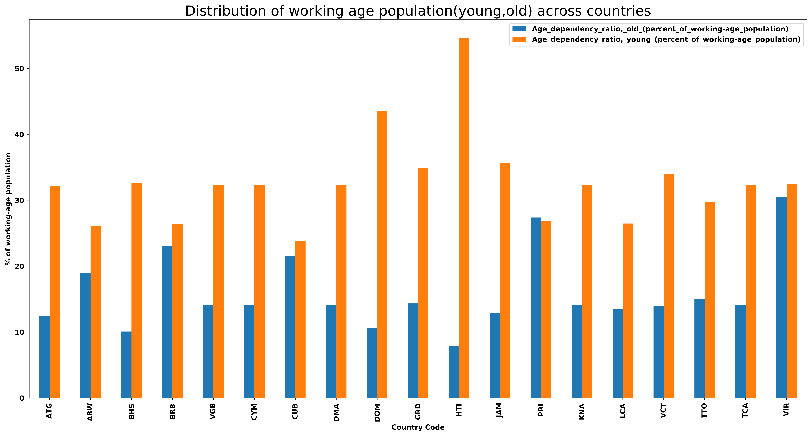
Highest Age Dependency Ratio, Young

Slide 13
Haiti
Opportunities: Frontier Market
Energy
Education
Health
Risks and Challenges
Unstable political conditions
Potentially high human capital costs
Exposure to potential natural disasters/losses

Slide 14
Age Dependency Ratio, Old vs Young

Slide 15
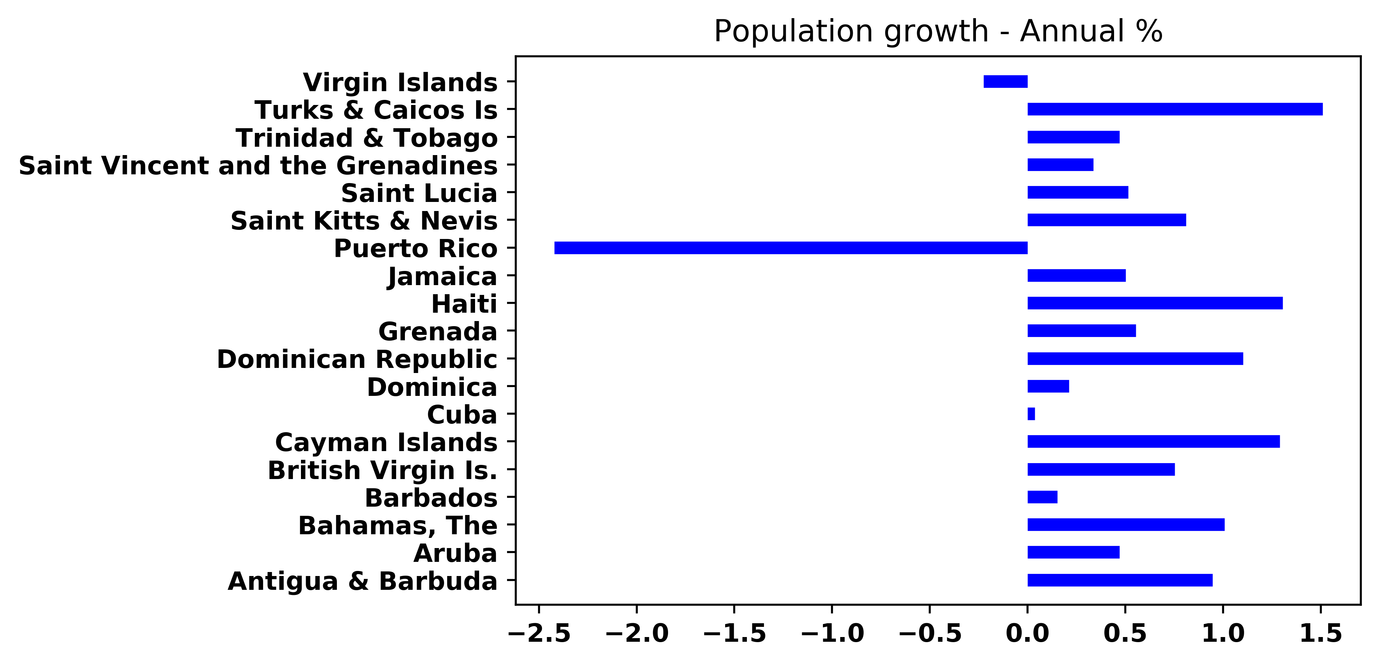
Lowest Population Growth Rate - Puerto Rico

Slide 16

Puerto Rico
Demographics
Highest GDP
Lowest service contribution to GDP
2nd lowest GDP growth
Lowest birth rate
Declining population
Aging population
US territory
Opportunities
Tourism industry
Elderly care
Automation, AI and robotics
Challenges
Exposure to potential natural disasters/losses
Declining working-age population

Slide 17
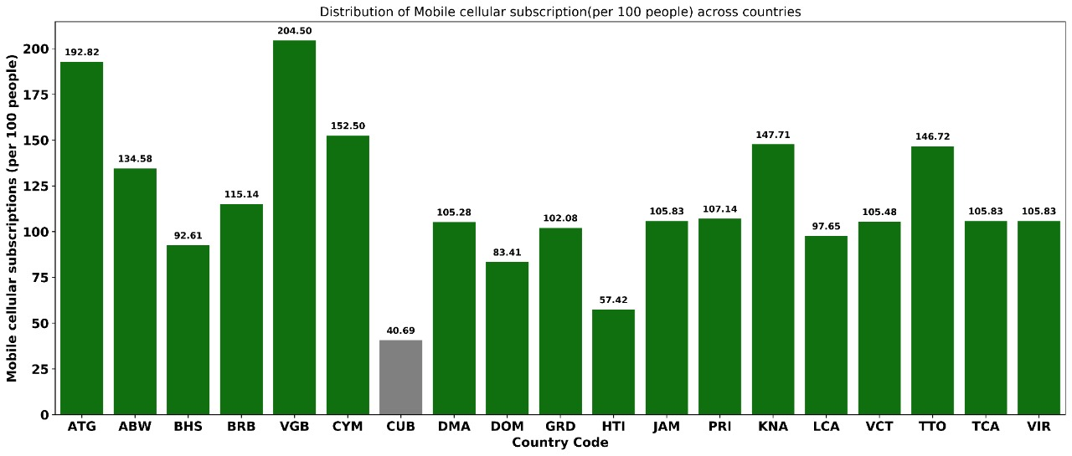
Lowest Mobile Cellular Subscription

Slide 18

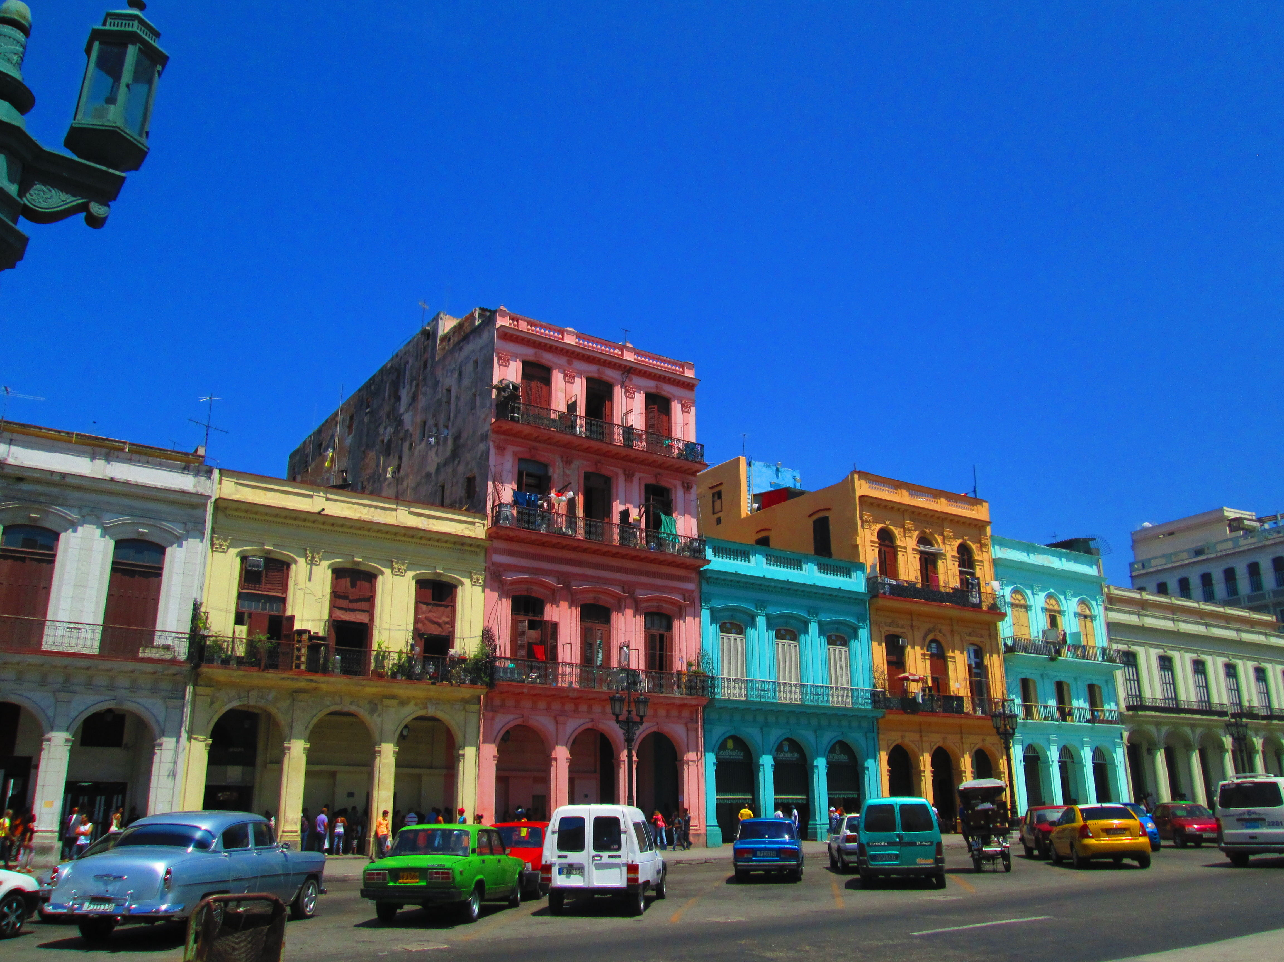
Cuba
Lowest mobile subscription rate (per 100 people)
Upper-middle income country
Largest population and surface area
2nd highest GDP
Socialist country: internet restrictions
Policy changes and deregulation of telecom industry
Increasing mobile subscriptions provide opportunities
Tax, legislative and administrative environment
This Photo by Unknown Author is licensed under CC BY-ND

Slide 19


Other Interesting Statistics
Relatively High Death Rates - Prevalence of Cancer
Low survival rather than high risk of cancer
Isolated (and relatively small) nations
Suboptimal cancer infrastructure
Lack of cancer control programs
Good Access to Electricity
Possible challenges within the region
Deeper analysis reveals surprise: Haiti

Slide 20
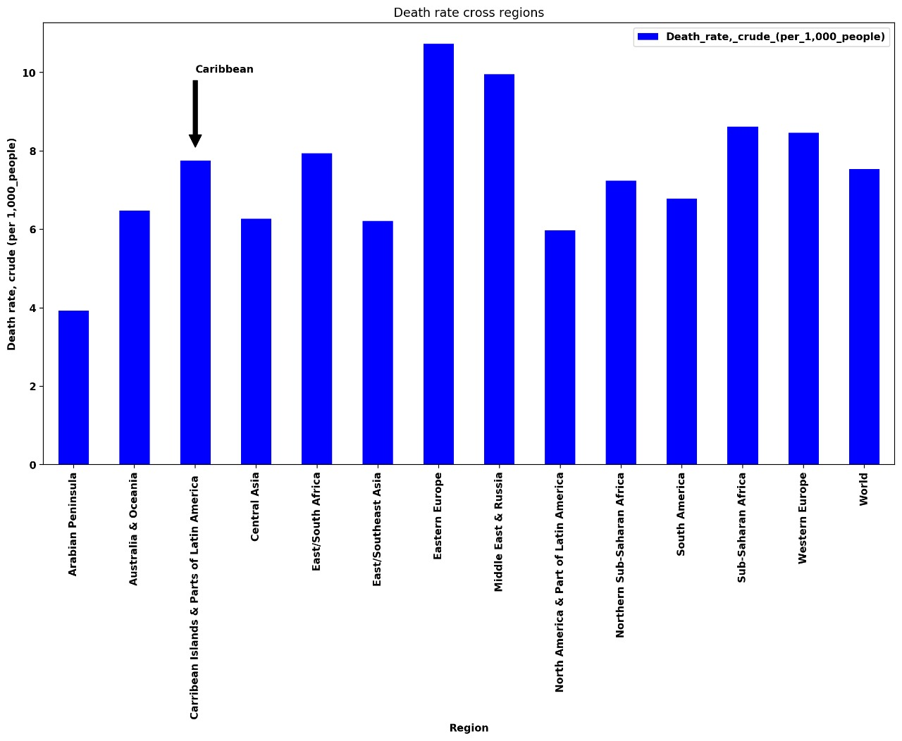
World Death Rates

Slide 21
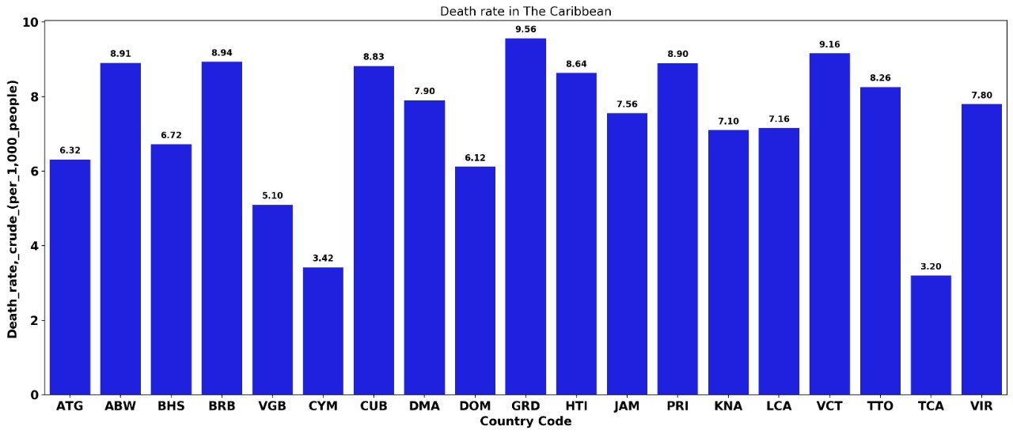
Death Rate in The Caribbean

Slide 22
Access to Electricity: Region with Haiti

Slide 23
Access to Electricity: Without Haiti

Slide 24

Limitations
Data Integrity
Data Source Reliability
Metadata Definition
Data Availability
This Photo by Unknown Author is licensed under CC BY

Slide 25
Conclusion
Different income brackets
Lowest GDP but not poor
Tax enforcement for development

Slide 26
THANK YOU
Insert Image

Slide 27

Q&A

Slide 28
References
Abel, J., & Deitz, R. (2014). The Causes and Consequences of Puerto Rico’s Declining Population [PDF]. Federal Reserve Bank of New York. Retrieved from https://www.newyorkfed.org/medialibrary/media/research/current_issues/ci20-4.pdf
Borji, H. (2016). 4 Global Economic Issues of an Aging Population. Retrieved 1 November 2019, from https://www.investopedia.com/articles/investing/011216/4-global-economic-issues-aging-population.asp
Busby, L. (2003). General Data Challenges Facing the Caribbean In The Context Of Sustainable Development [PDF]. Retrieved from https://www.un.org/esa/sustdev/natlinfo/indicators/idsd/workshops/workshop1pdf/eclac.pdf
Caribbean360. (2019). Cancer is Now Second Leading Cause of Death in the Caribbean | Caribbean360. Retrieved 1 November 2019, from http://www.caribbean360.com/news/cancer-is-now-second-leading-cause-of-death-in-the-caribbean
Cattin, L., Pinheiro, P., Callahan, K., & Hage, R. (2017). Twenty-first century cancer patterns in small island nations: Grenada and the English-speaking Caribbean. Cancer Causes & Control, 28(11), 1241-1249. doi: 10.1007/s10552-017-0960-5
CIA. Central America :: British Virgin Islands — The World Factbook - Central Intelligence Agency. Retrieved 1 November 2019, from https://www.cia.gov/library/publications/the-world-factbook/geos/print_vi.html
Coto, D. (2019). Haiti unrest disrupts hospitals and schools, UN says. Retrieved 1 November 2019, from https://www.pbs.org/newshour/world/haiti-unrest-disrupts-hospitals-and-schools-un-says
IndexMundi. (2018). British Virgin Islands Death rate - Demographics. Retrieved 1 November 2019, from https://www.indexmundi.com/british_virgin_islands/death_rate.html
IndexMundi. (2018). Dominica Birth rate - Demographics. Retrieved 1 November 2019, from https://www.indexmundi.com/dominica/birth_rate.html
IndexMundi. (2018). Dominica Death rate - Demographics. Retrieved 1 November 2019, from https://www.indexmundi.com/dominica/death_rate.html
IndexMundi. (2016). Employment in industry (% of total employment) (modeled ILO estimate) - Country Comparison. Retrieved 1 November 2019, from https://www.indexmundi.com/facts/indicators/SL.IND.EMPL.ZS/compare?country=vi'
IndexMundi. (2016). Virgin Islands - Employment in services (% of total employment) (modeled ILO estimate) - Country Comparison. Retrieved 1 November 2019, from https://www.indexmundi.com/facts/indicators/SL.SRV.EMPL.ZS/compare?country=vi
IndexMundi. (2018). British Virgin Islands Total fertility rate - Demographics. Retrieved 1 November 2019, from https://www.indexmundi.com/british_virgin_islands/total_fertility_rate.html
IndexMundi. (2018). Cayman Islands Total fertility rate - Demographics. Retrieved 1 November 2019, from https://www.indexmundi.com/cayman_islands/total_fertility_rate.html
IndexMundi. (2018). Saint Kitts and Nevis Birth rate - Demographics. Retrieved 1 November 2019, from https://www.indexmundi.com/saint_kitts_and_nevis/birth_rate.html
IndexMundi. (2018). Saint Kitts and Nevis Death rate - Demographics. Retrieved 1 November 2019, from https://www.indexmundi.com/saint_kitts_and_nevis/death_rate.html
IndexMundi. (2018). Saint Kitts and Nevis Total fertility rate - Demographics. Retrieved 1 November 2019, from https://www.indexmundi.com/saint_kitts_and_nevis/total_fertility_rate.html
IndexMundi. (2018). Turks and Caicos Islands Birth rate - Demographics. Retrieved 1 November 2019, from https://www.indexmundi.com/turks_and_caicos_islands/birth_rate.html
IndexMundi. (2018). Turks and Caicos Islands Death rate - Demographics. Retrieved 1 November 2019, from https://www.indexmundi.com/turks_and_caicos_islands/death_rate.html
IndexMundi. (2018). Turks and Caicos Islands Total fertility rate - Demographics. Retrieved 1 November 2019, from https://www.indexmundi.com/turks_and_caicos_islands/total_fertility_rate.html
Kao, G. (2018). The Future of Human Work? Empathy. Retrieved 1 November 2019, from https://medium.com/@georgekao/the-future-of-human-work-empathy-614f6252be56
Marr, B. (2018). 7 Job Skills Of The Future (That AIs And Robots Can't Do Better Than Humans). Retrieved 1 November 2019, from https://www.forbes.com/sites/bernardmarr/2018/08/06/7-job-skills-of-the-future-that-ais-and-robots-cant-do-better-than-humans/#7ba4d6af6c2e
Marsh, S., & Grebler, D. (2019). Cuba legalizes private Wi-Fi networks in bid to boost connectivity. Retrieved 1 November 2019, from https://www.reuters.com/article/us-cuba-internet/cuba-legalizes-private-wi-fi-networks-in-bid-to-boost-connectivity-idUSKCN1SZ2UD
Michigan State University. (2019). Cayman Islands: Economy. Retrieved 1 November 2019, from https://globaledge.msu.edu/countries/cayman-islands/economy
OECD. (2019). Revenue Statistics in Latin America and the Caribbean 2019. Retrieved 1 November 2019, from https://www.oecd.org/ctp/revenue-statistics-in-latin-america-and-the-caribbean-24104736.htm
Paula Curado, M., & Bezerra de Souza, D. (2014). Cancer Burden in Latin America and the Caribbean. Annals Of Global Health, 80(5), 370-376. doi: 10.1016/j.aogh.2014.09.009
Rajack-Talley, T. (2016). Rural Employment and Rural Development In The Caribbean [PDF] (pp. 6-7). International Labour Organization. Retrieved from https://www.ilo.org/wcmsp5/groups/public/---americas/---ro-lima/---sro-port_of_spain/documents/publication/wcms_533997.pdf
The World Bank Group. Why are some data not available? – World Bank Data Help Desk. Retrieved 1 November 2019, from https://datahelpdesk.worldbank.org/knowledgebase/articles/191133-why-are-some-data-not-available
Semple, K., & Cohen, H. (2019). Cuba Expands Internet Access to Private Homes and Businesses. Retrieved 1 November 2019, from https://www.nytimes.com/2019/07/29/world/americas/cuba-internet-technology.html

Slide 29
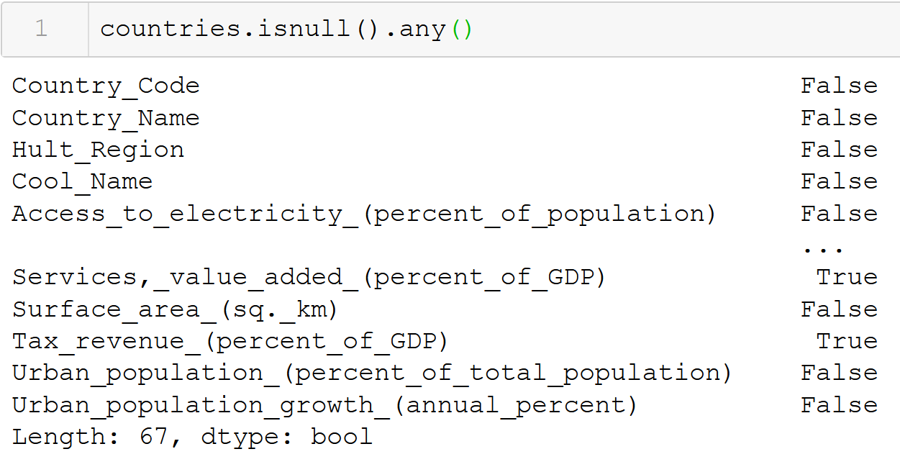
Appendix 1 – Checking Missing Values

Slide 30
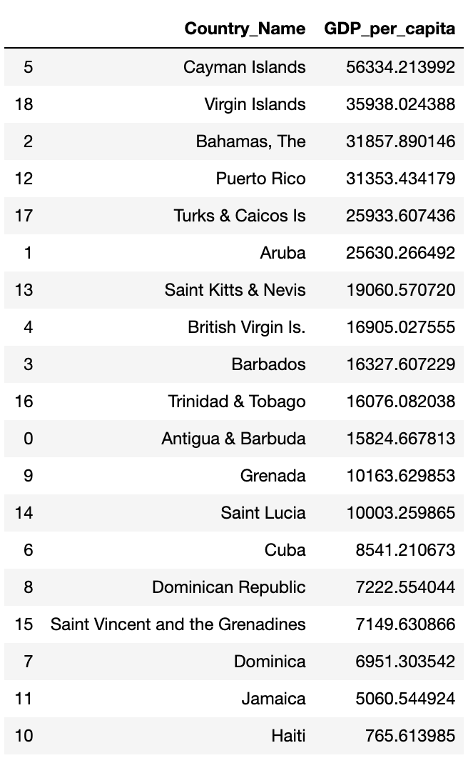
Appendix 2 - GDP per Capita

Slide 31
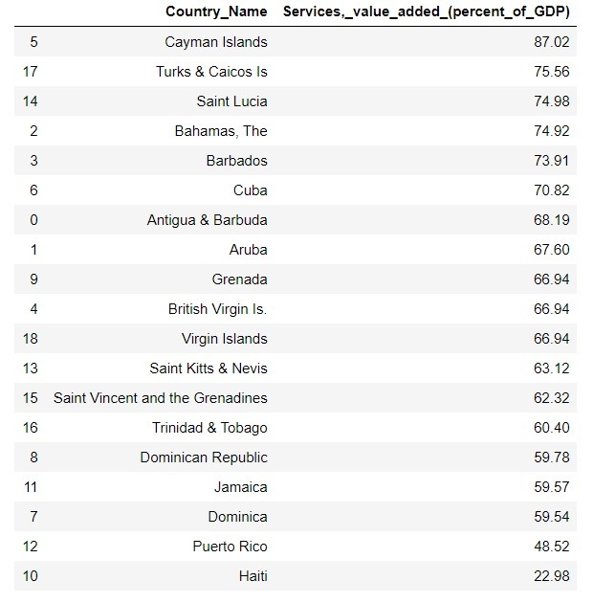
Appendix 3 – Economic Sector: Services

Slide 32
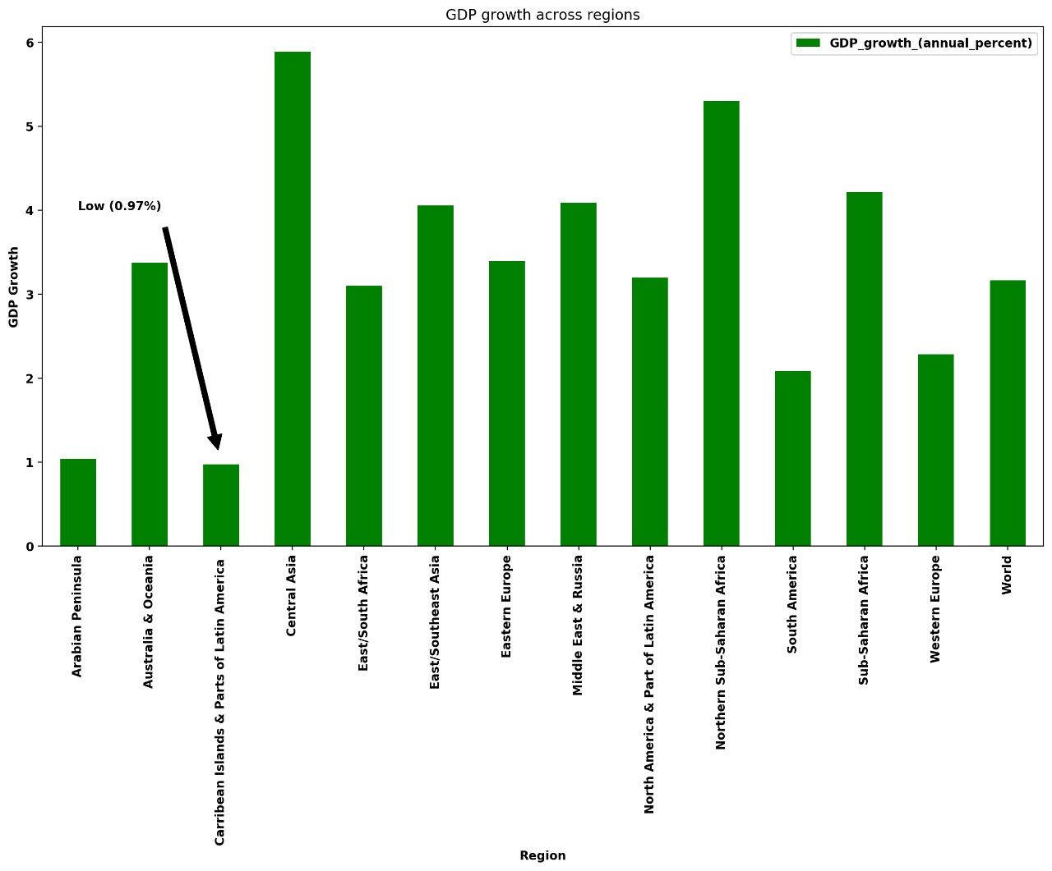
Appendix 4 – GDP Growth Rates

Slide 33
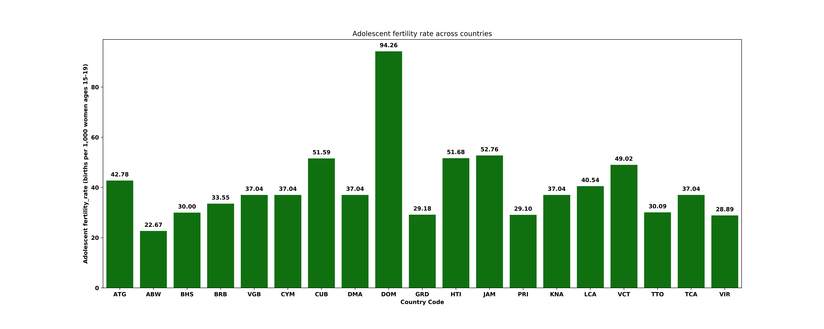
Appendix 5 – Adolescent Fertility Rates

Slide 34
Appendix 6 - Correlations

